Slide 1
Airline Flight Booking System
Flask Database Project
By: Bhavin Patel, Nathan Olson, and Robert bitunjac

Slide 2
Who/What is this being developed for?
This application is being developed for airline customers and staff.
To be a safe, operationally efficient, customer-centric, technology-driven airline that sustains itself through modern, innovative management.

Slide 3
What is the purpose and scope of this project?
Can be a lengthy process to book flights and can be restricted to where and when.
Provide an easy and less time-consuming flight booking from anywhere.
We chose not to include

Slide 4
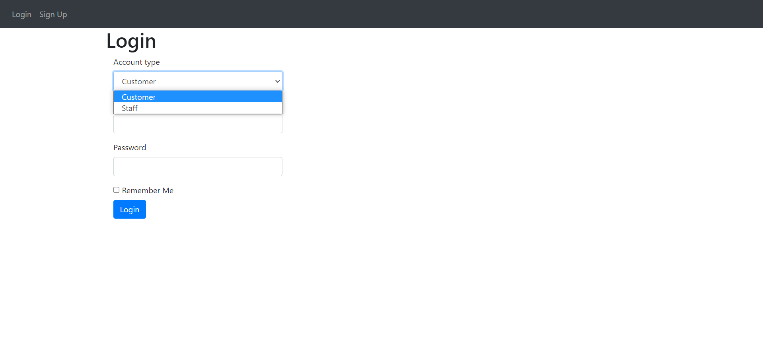
Users of the project
Customers
Staff
Notes:
Access Control is implemented by dropdown list where user either select Customer or Staff

Slide 5
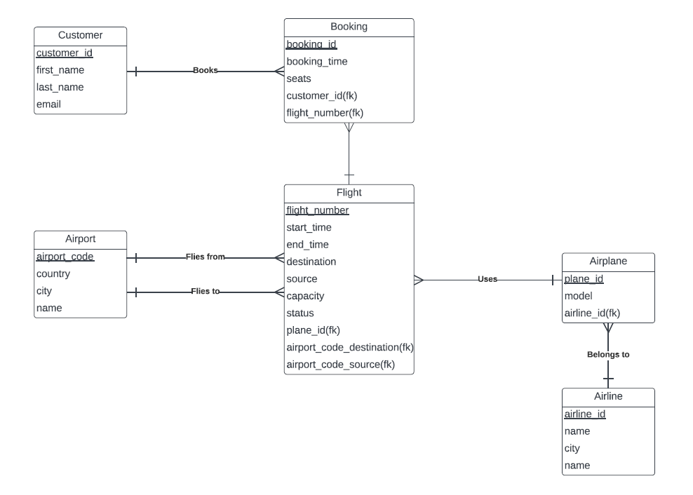
ERD
Notes:
Customer books flight which flies from an airport and flies to another airport using airplane which belongs to an airline

Slide 6
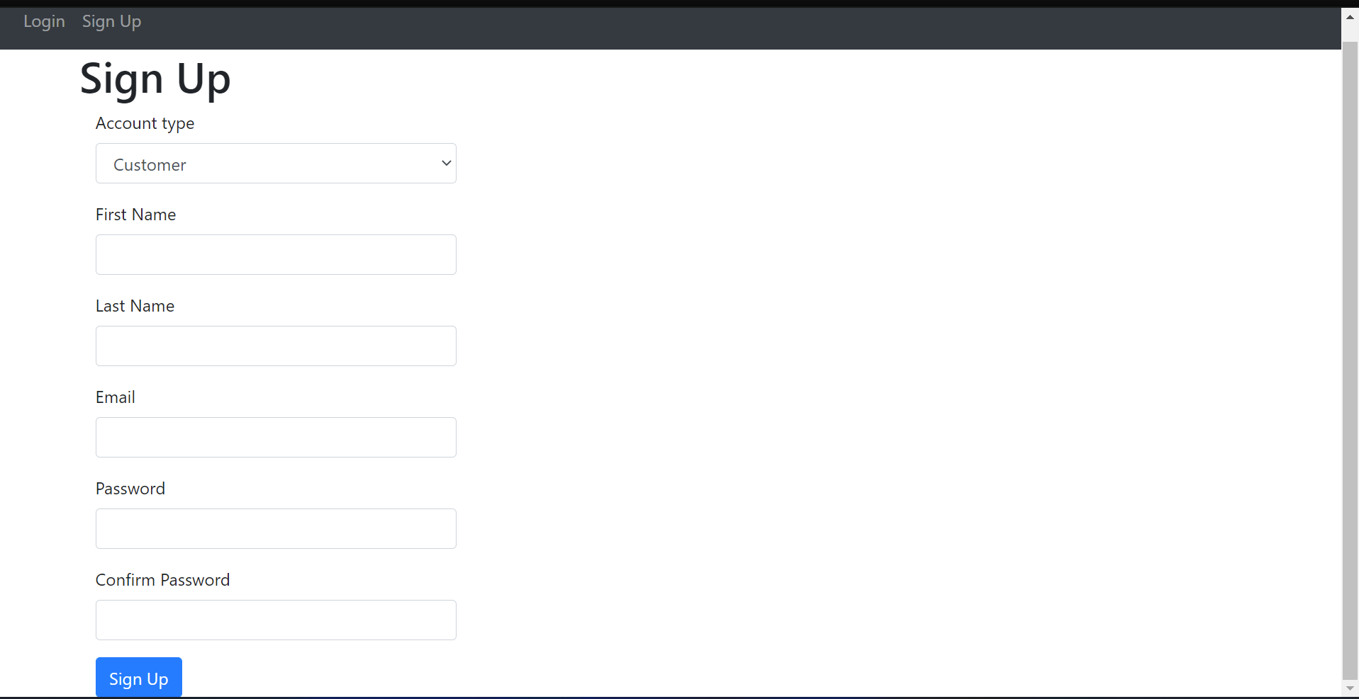
Walkthrough

Slide 7
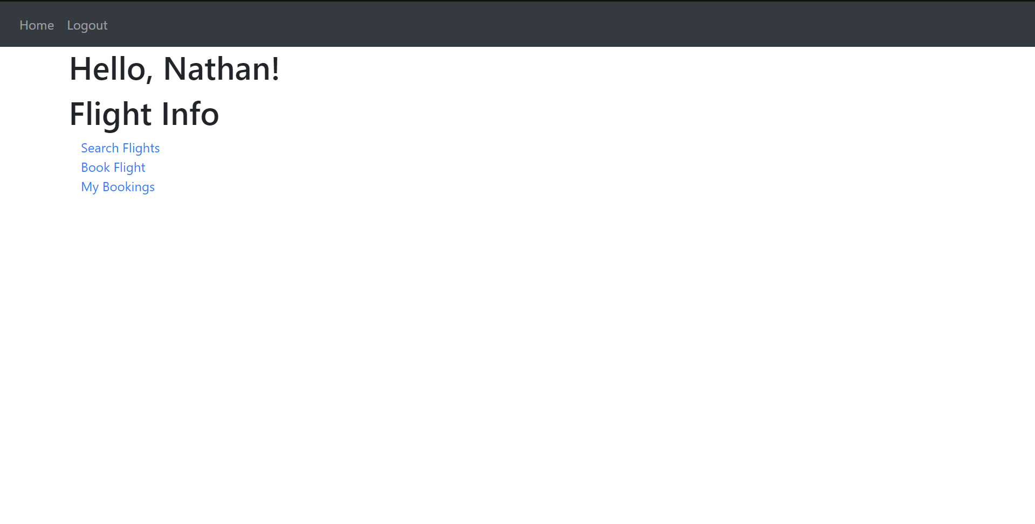

Slide 8
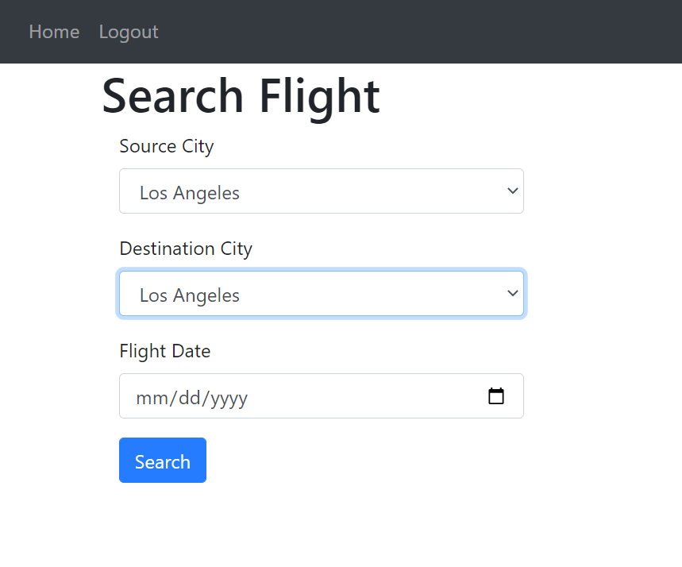
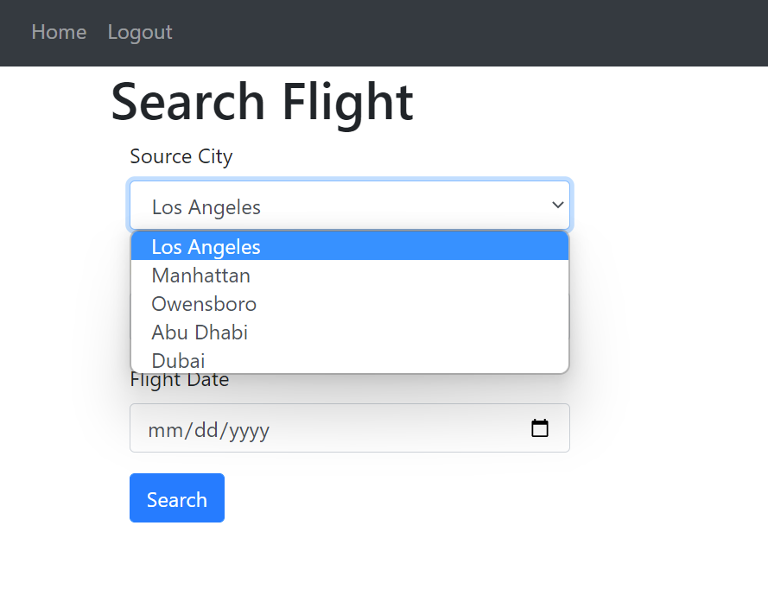
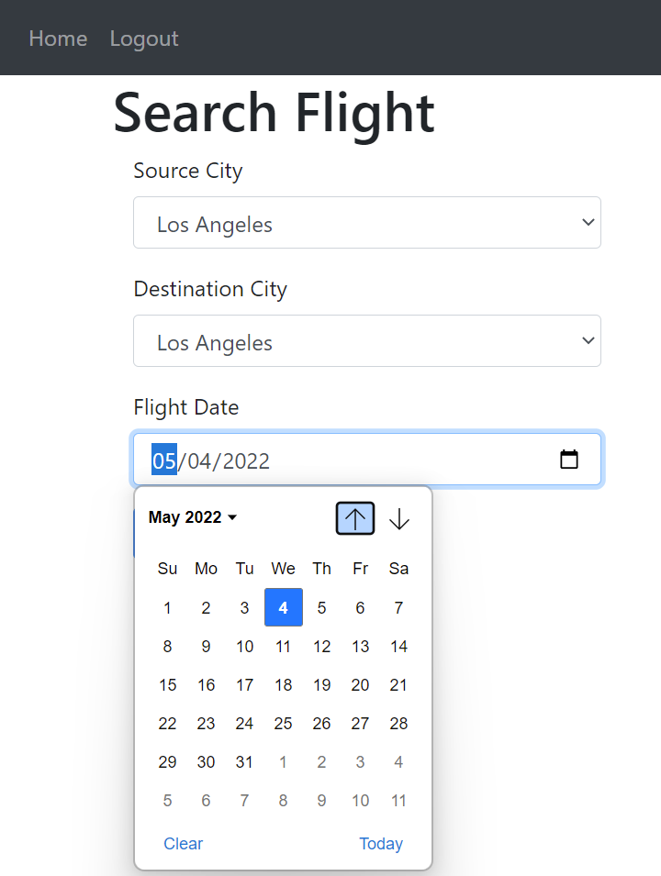

Slide 9
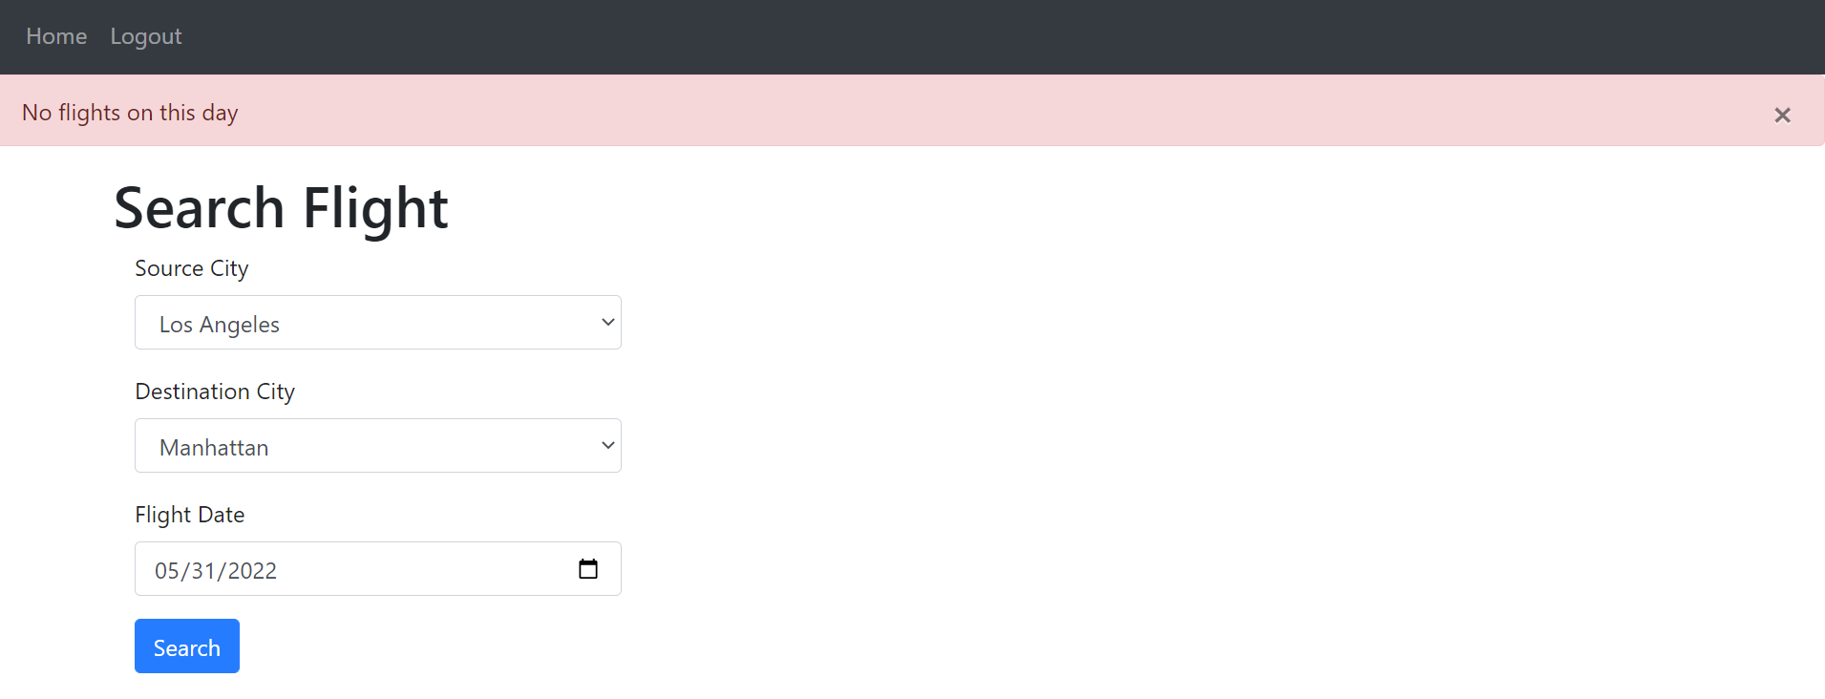
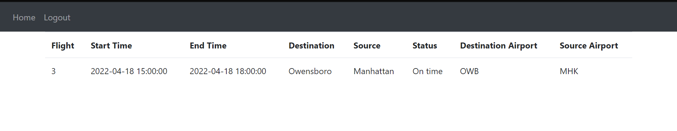

Slide 10
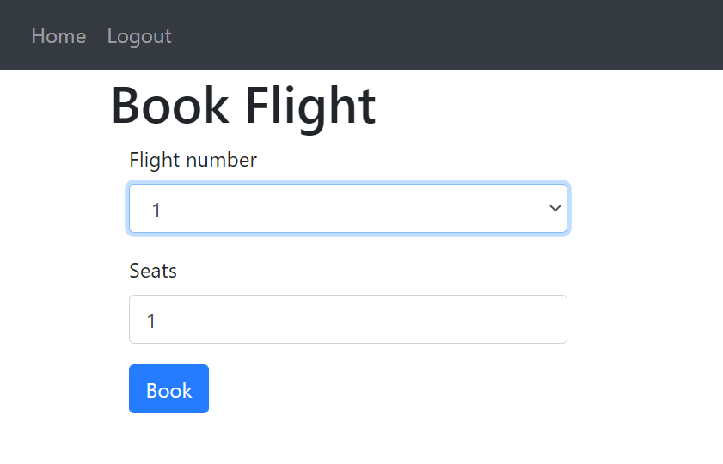
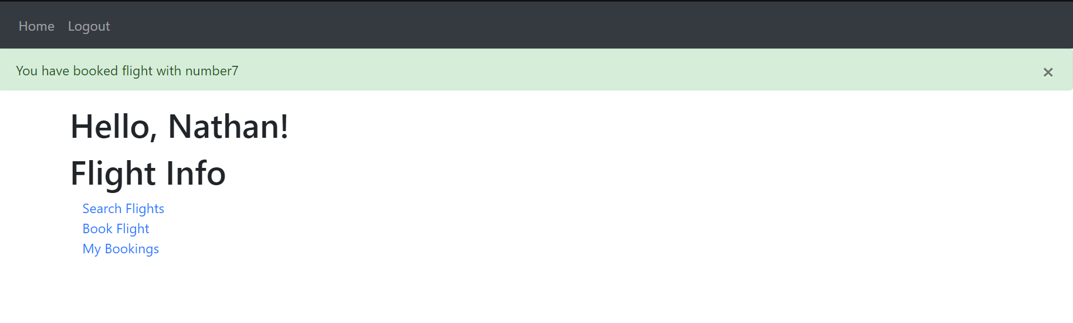
Book Flight

Slide 11
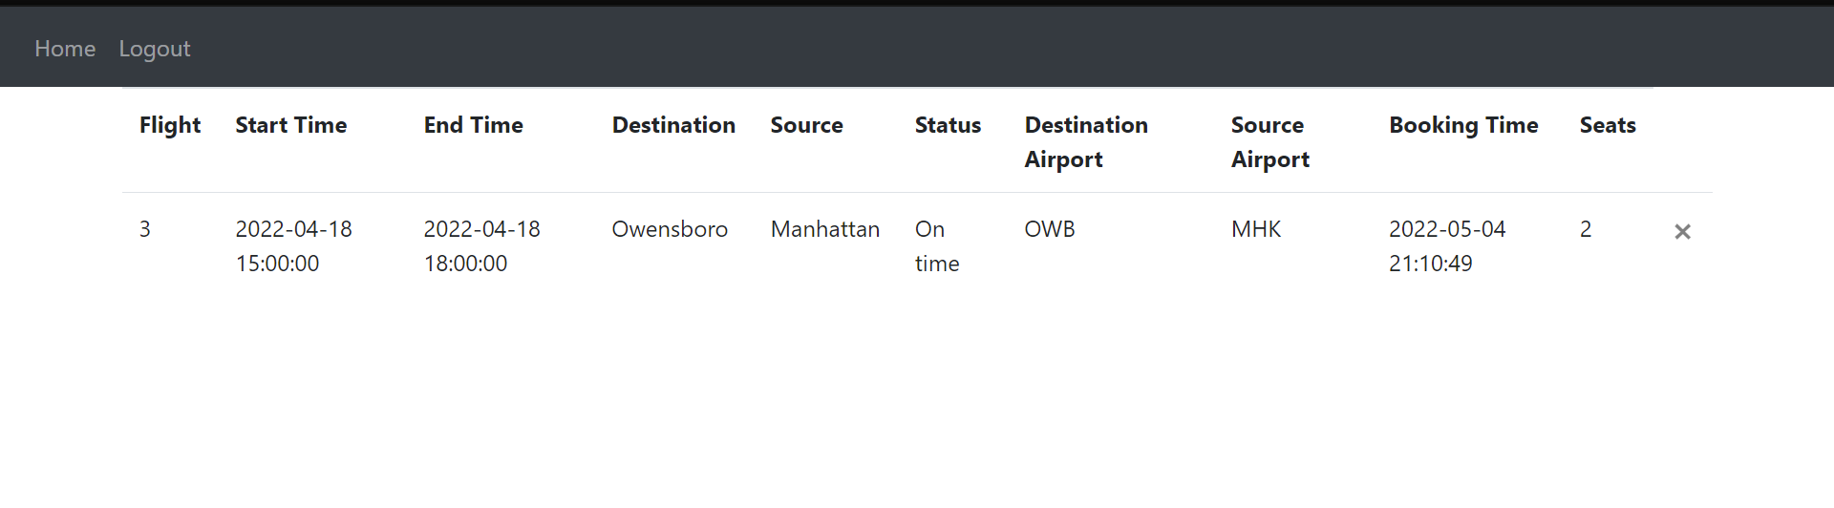
My Bookings

Slide 12
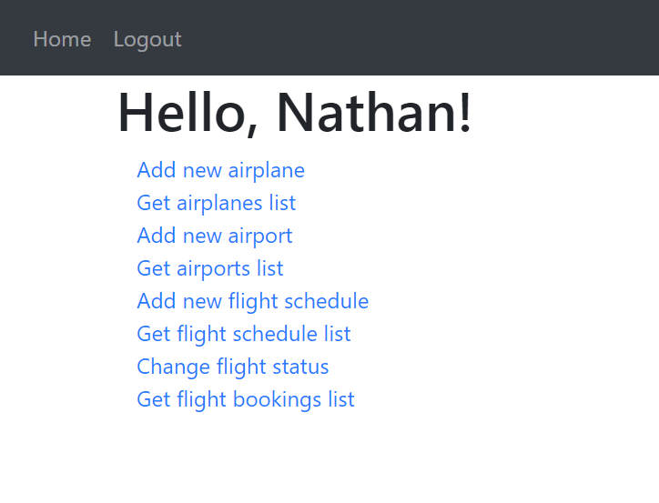
Staff

Slide 13
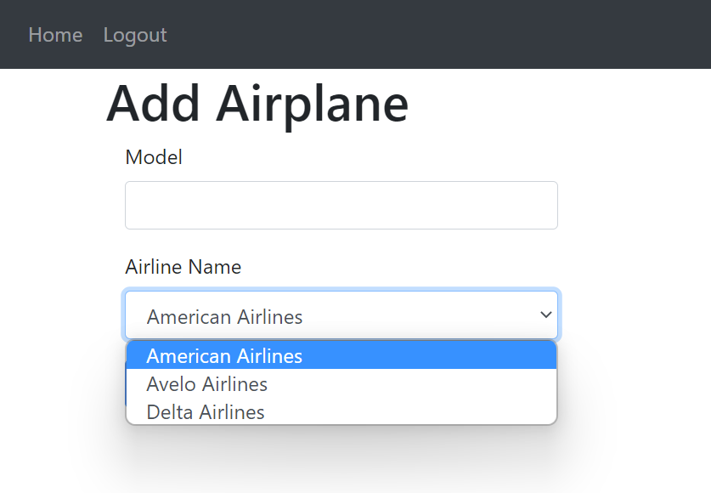


Slide 14
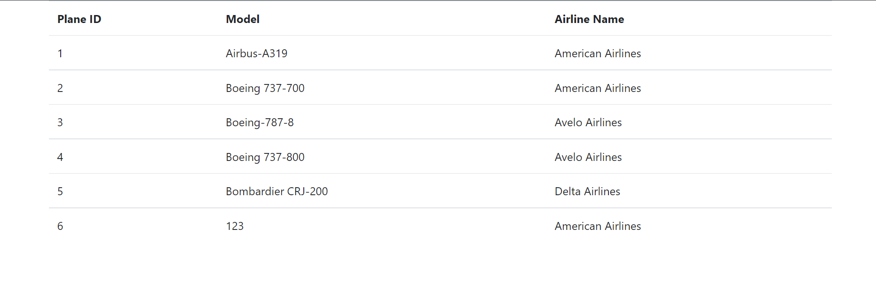
Check Airplane List

Slide 15
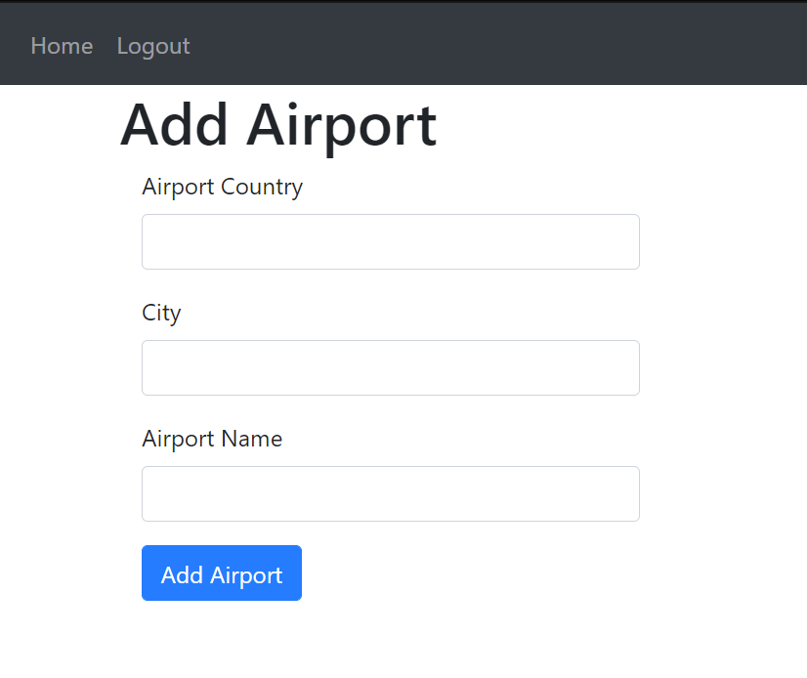


Slide 16
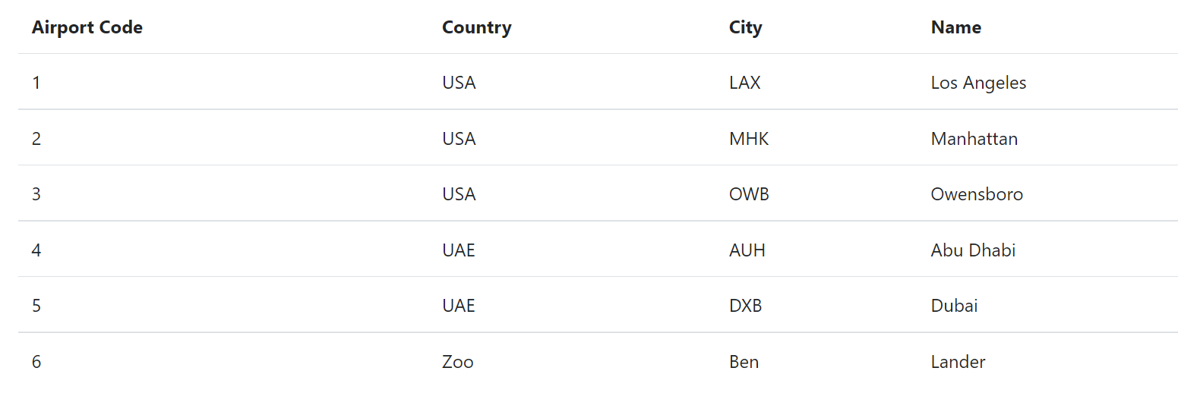
Get Airports List

Slide 17
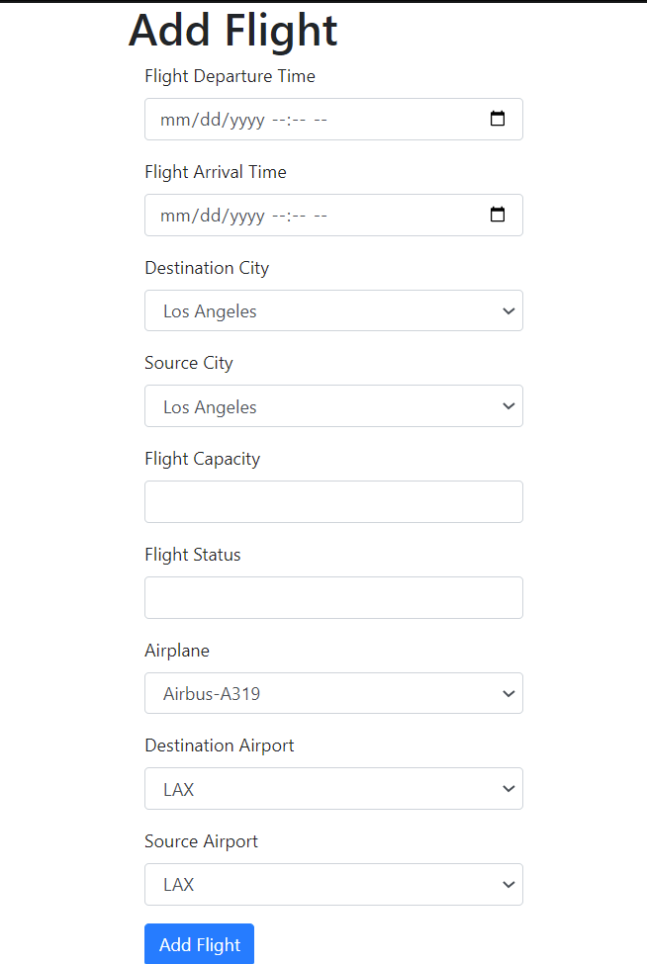

Slide 18
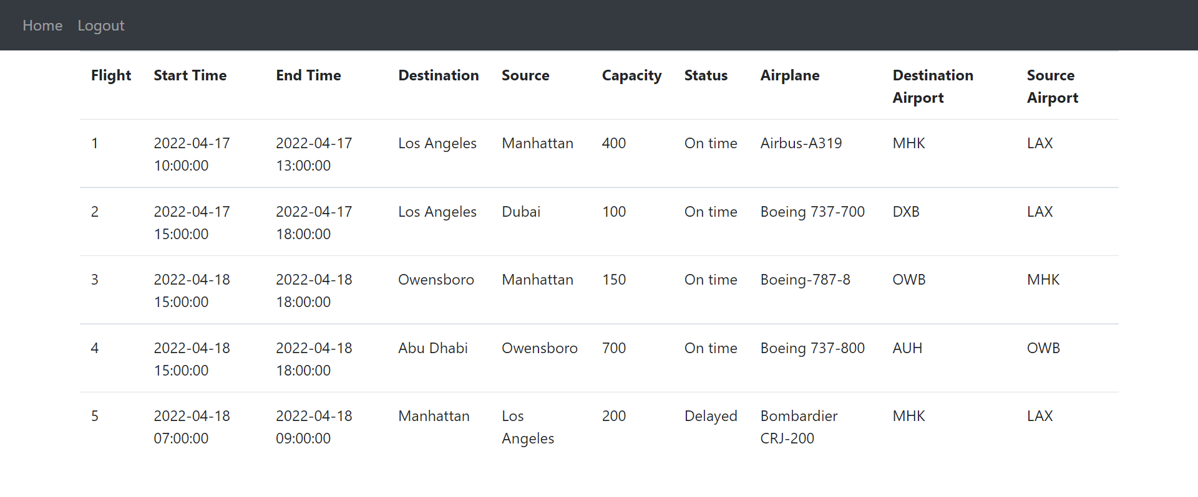
Check Flight Schedule List

Slide 19
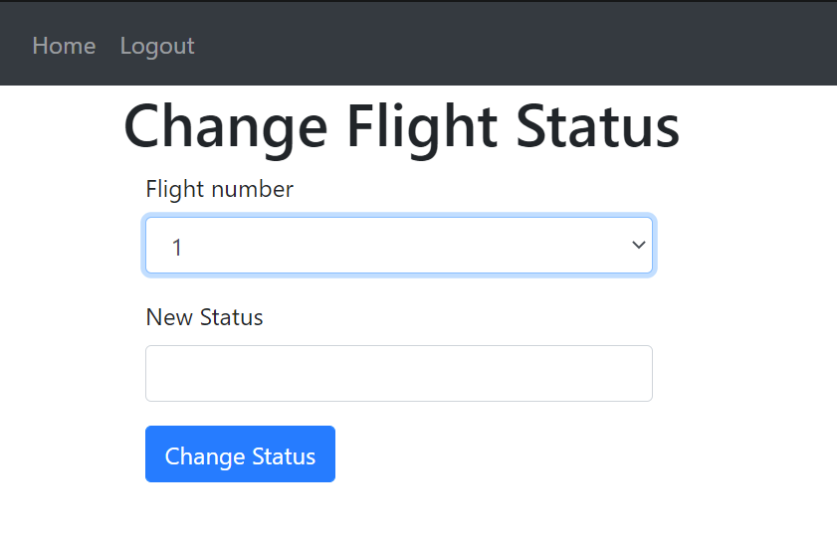

Slide 20
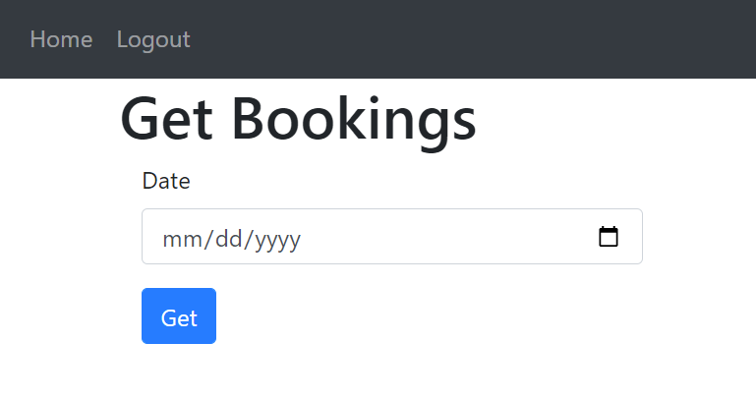
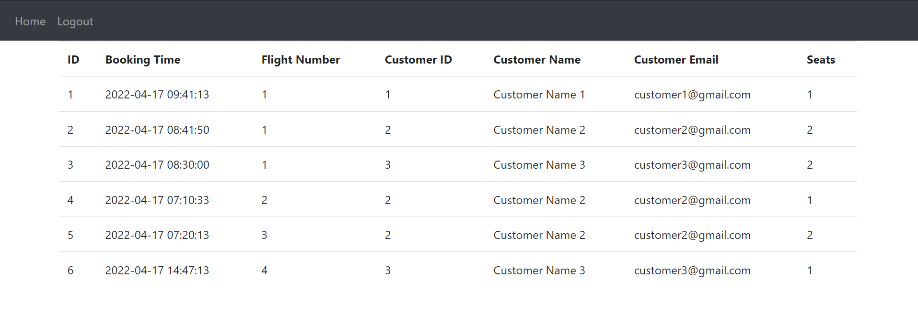

Slide 21
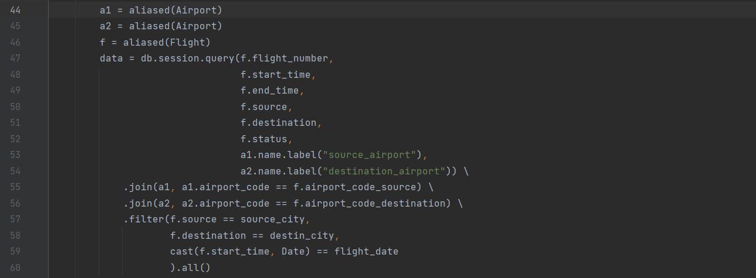
Flight Search Query
Notes:
A little bit complicated query

Slide 22
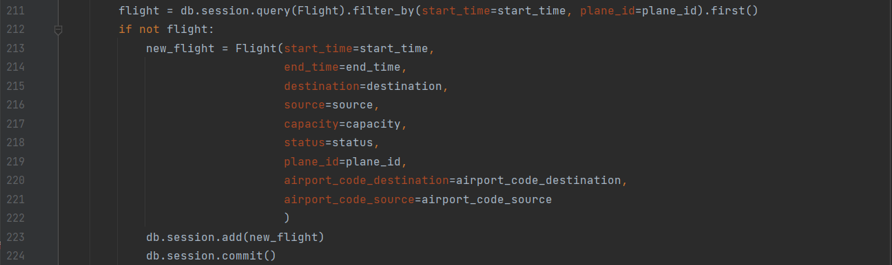
Create
Notes:
Staff adds new flight

Slide 23
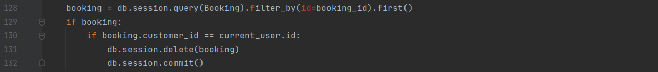
Read, Update, and Delete
Notes:
Staff updates flight status to new status

Slide 24
How does it solve the issue?
This system makes it easy to search for and book flights in our database.
Flights and bookings can be made in seconds.
Allows the user to look up their flights for easy access

